Slide 1

HTML Forms

Slide 2
What are some uses of forms?
Forms are used to collect user input.
Examples that you may be familiar with: Google Forms
More than often not, the user inputs would be sent to a server for processing

Slide 3
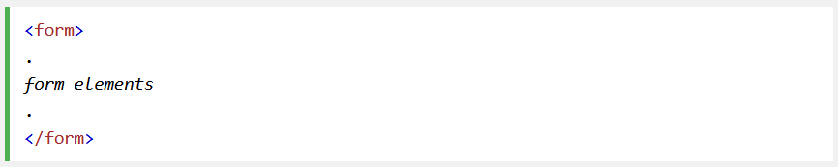
<Form> Element
HTML <form> element is used to create and HTML form for user input.
Generic syntax

Slide 4
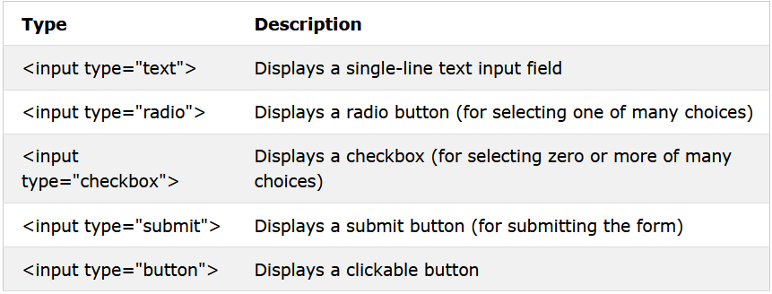
<input> Element
Inputs can be displayed in many different ways
E.g. text input, checkbox, etc.

Slide 5
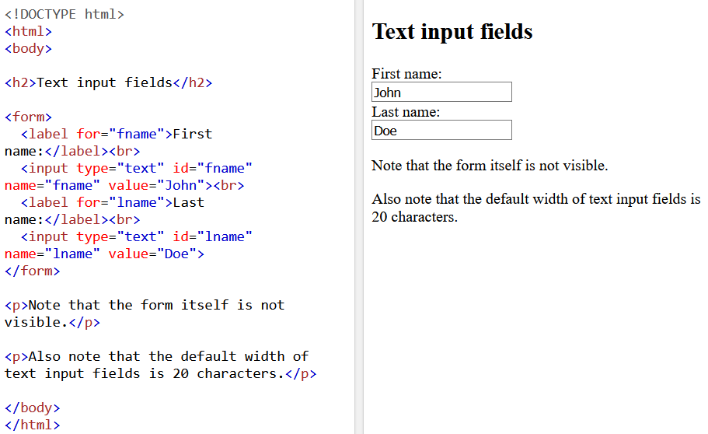
Text Fields
Defines a single-line input filed for text input
Notes:
Default width of 20 character size.
Disable attribute
Size attribute
Maxlength attribute

Slide 6
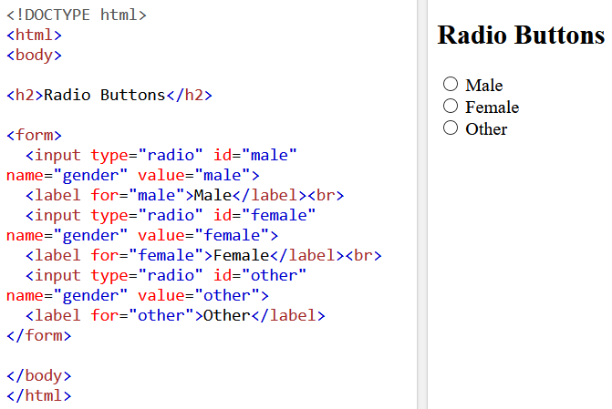
Radio Buttons
Allows user to select ONE of a limited number of choices

Slide 7
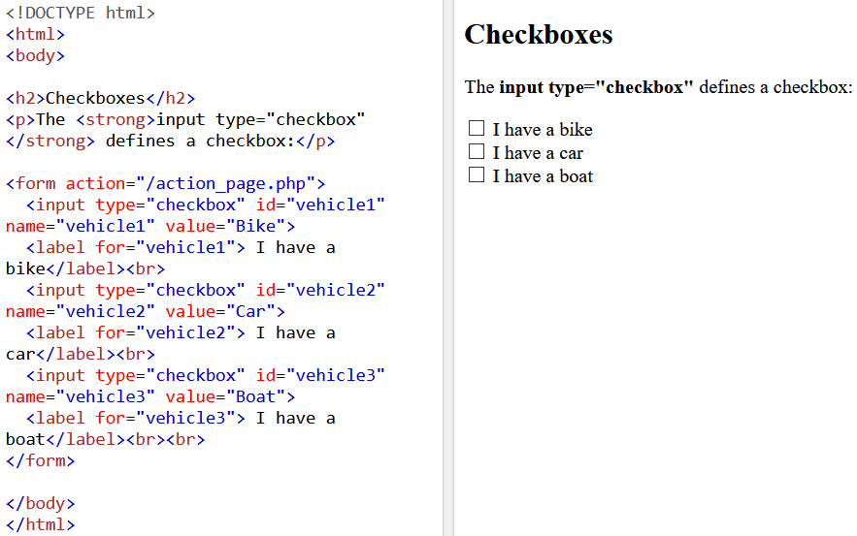
Checkboxes
Allows user to select ONE or MORE of a limited number of choices

Slide 8
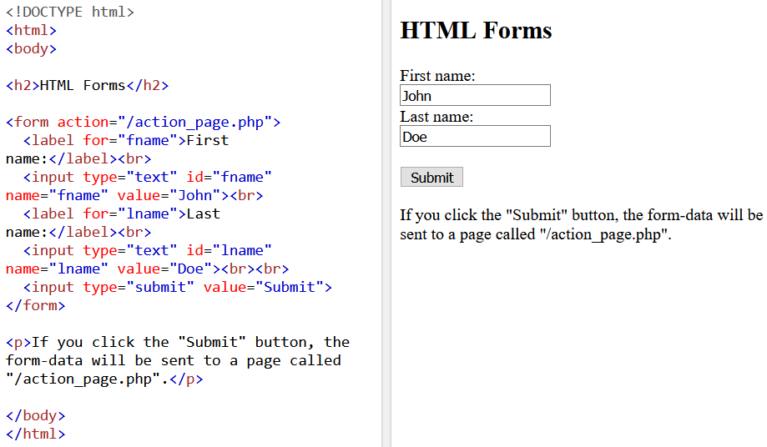
Submit Button
Defines a button for submitting the data to a server.
Notes:
Note, we will not be going through the backend stuff
Note: “Submit” button by default is “submit query”. Add in value property to change its content

Slide 9
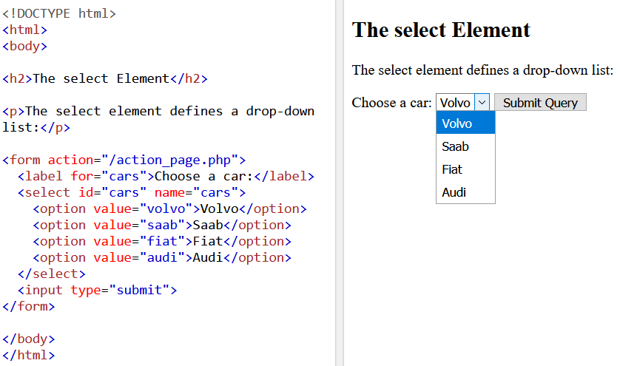
Drop-down List
Allows user to select from a drop-down list
Notes:
Note, we will not be going through the backend stuff

Slide 10
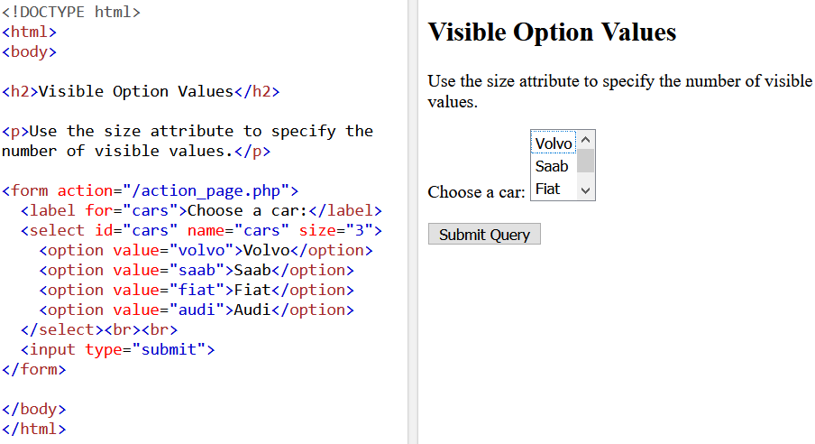
Visible List
Allows user to select from a drop-down list, but with elements visible of up to n.
Notes:
Note, we will not be going through the backend stuff

Slide 11
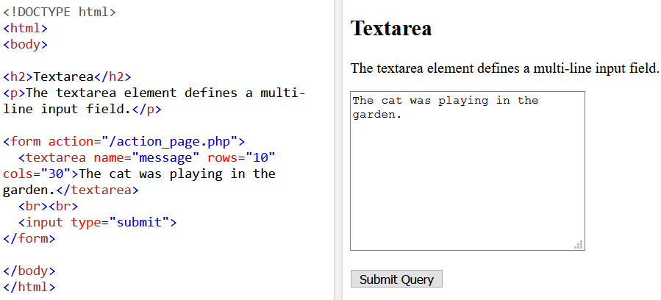
Text Area
Allows user to input texts in a boxed-up area.
Notes:
Note, we will not be going through the backend stuff

Slide 12
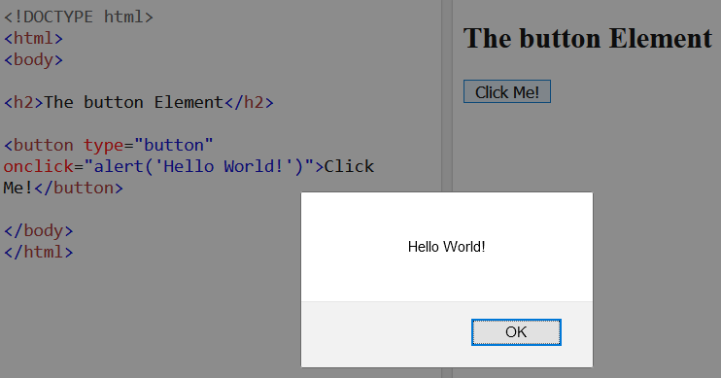
Pop-up window
Window pops-up when button is clicked
Notes:
Note, we will not be going through the backend stuff

Slide 13
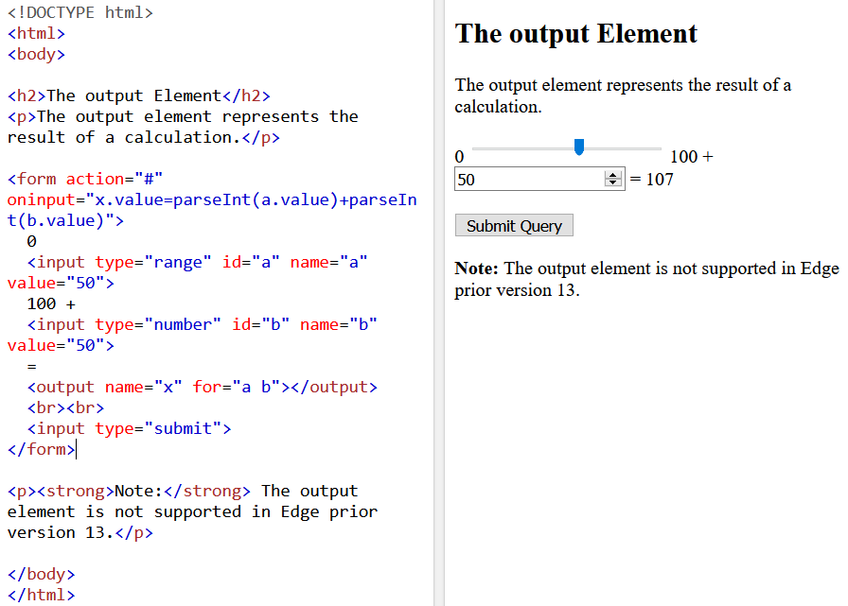
Output
Represents the result of a calculation
Notes:
Note, we will not be going through the backend stuff

Slide 14
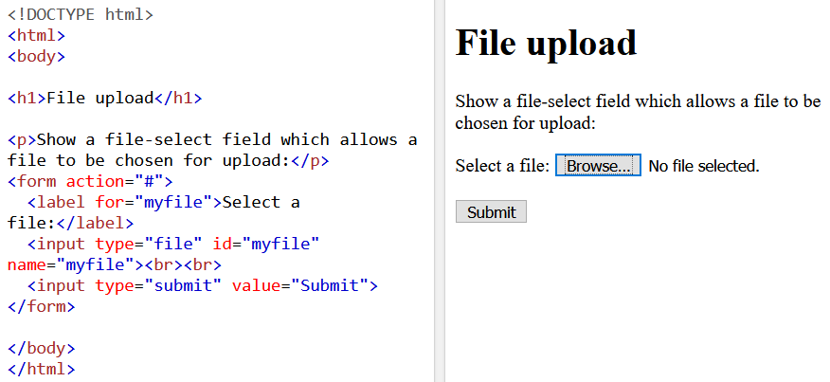
Browse
Opens up a window to browse for files
Notes:
Note, we will not be going through the backend stuff

Slide 15
Task 5
Create a form that allows user to input their name, age, and gender.
Create a simple text box where users can add in short description about themselves.

